Slide 1
HW3: Database Project
Library Application
Group 8 ( James M Northup, Jin Young Park)

Slide 2
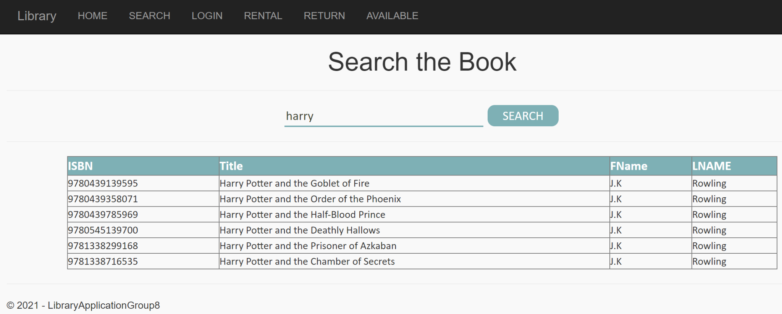
Application Description
Library Application allows users to
Search the Literature database
Log in for Additional Services
Rent Literature Using the ISBN
Return Literature Using the ISBN
Check Availability of Literature Using ISBN
Lookup User Checkout History

Slide 3
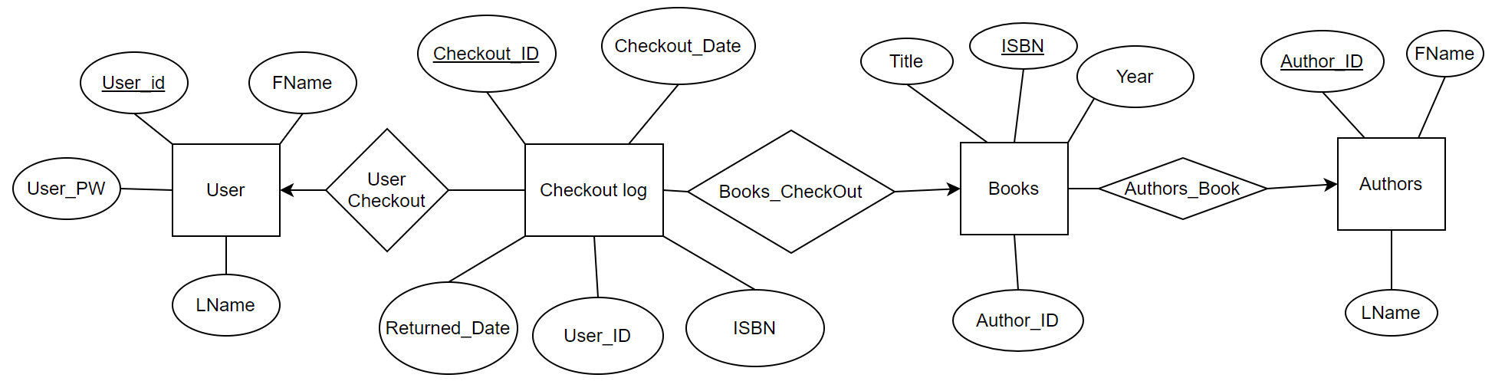
Back-End Design: DB Relational Diagram

Slide 4
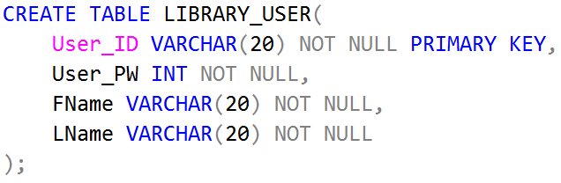
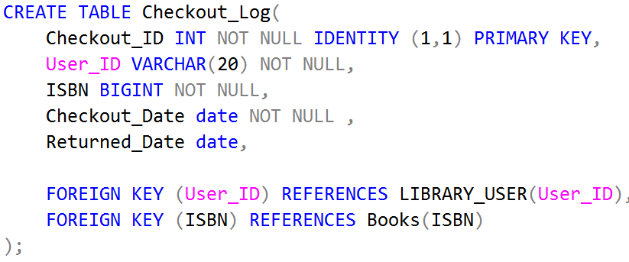
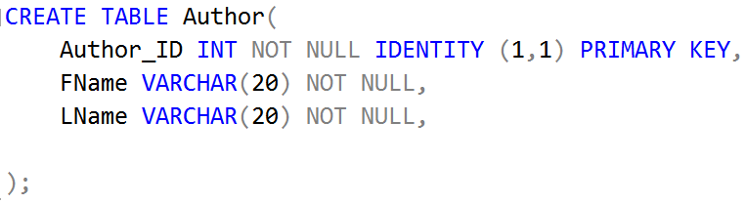
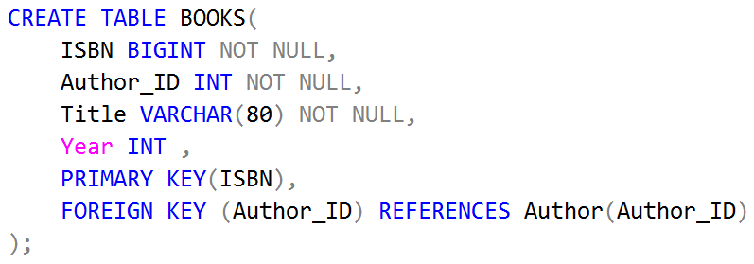
Back-End Design: DB Tables

Slide 5
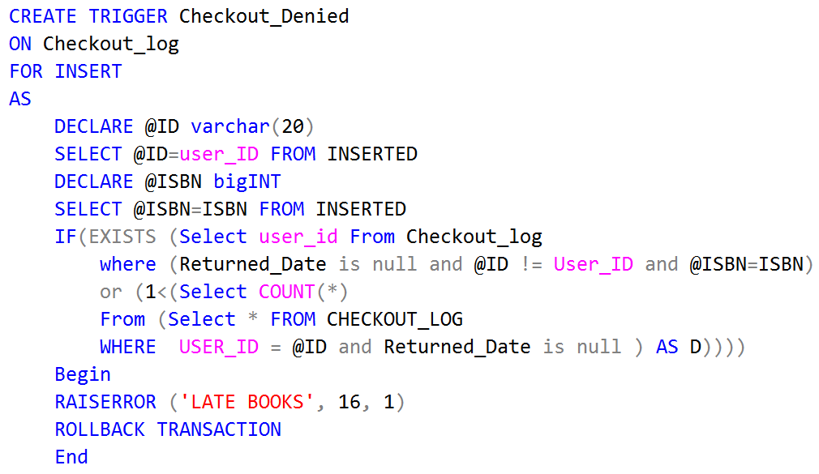
Functionality: Trigger

Slide 6
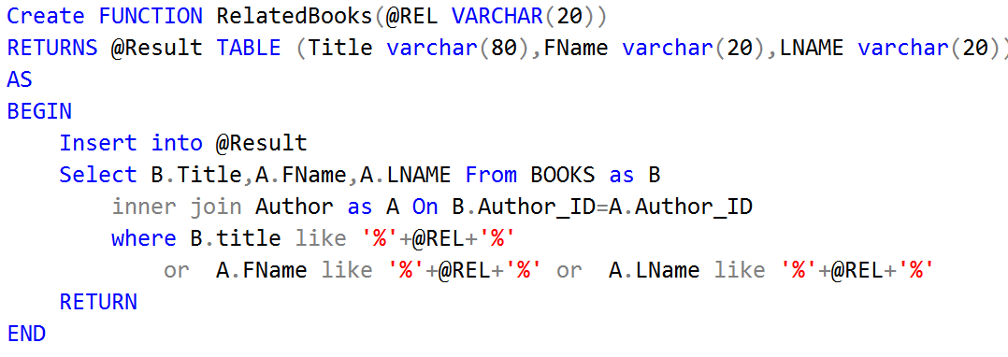
Functionality: Search Function

Slide 7
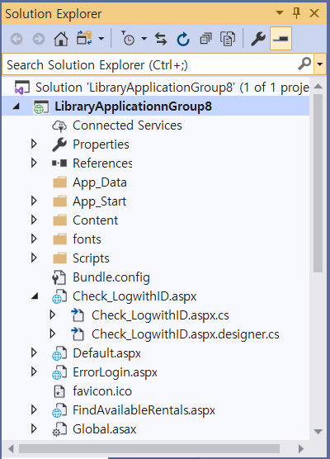
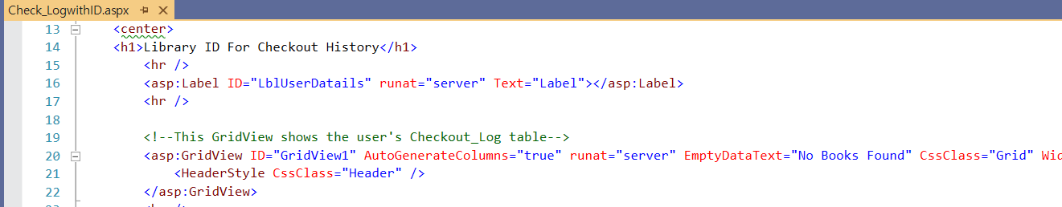
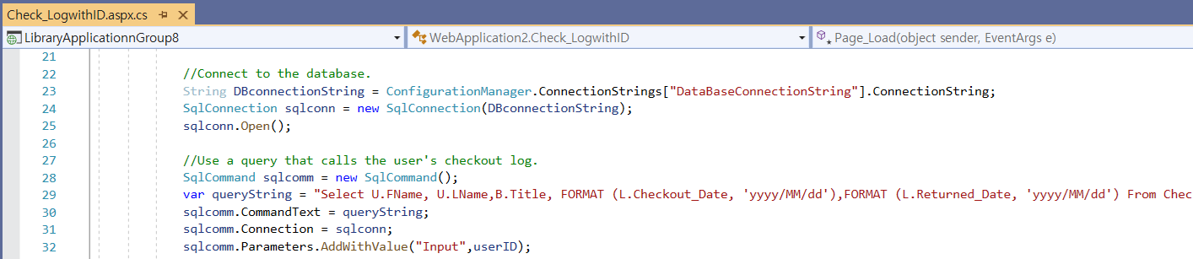
Create Front-end
Visual Studio 2019
html
C#
Query

Slide 8
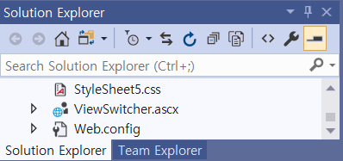
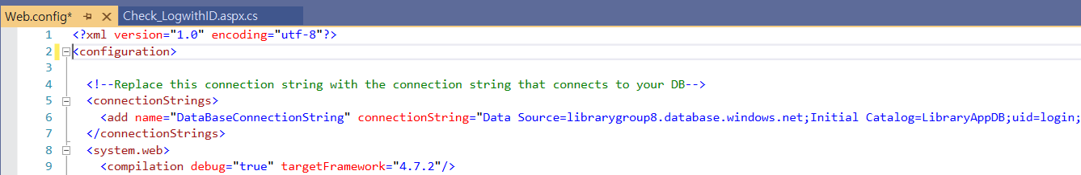
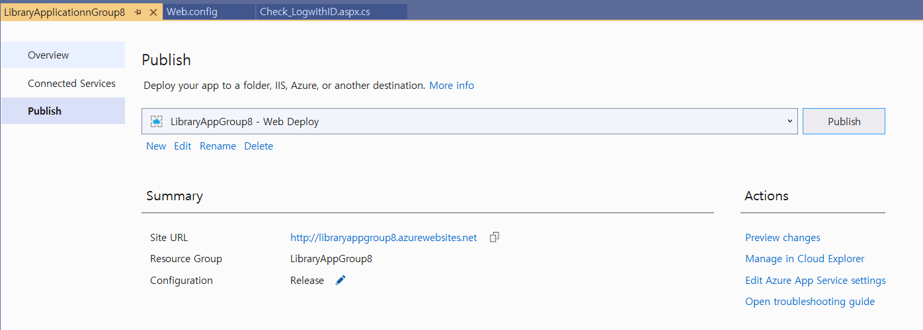
Implement Front-end
Connect to cloud server and DB
Cloud Server
Database
Publish the app to Azure web app

Slide 9
Demonstration
Application URL: http://libraryappgroup8.azurewebsites.net/

Slide 10
Conclusion
Create Library Application Function: Search, Rent, Return, Availability, Login
Back-end:
Create Database in our Cloud Server
Table: LIBRARY_USER, Author, BOOKS, and Checkout_Log
Trigger
Front-end: Use Visual Studio 2019
WebForm: HTML/ Handler: C#
Connect to the Cloud Server
Publish to Azure web app

Slide 11
Reference
Create Database in Azure: https://docs.microsoft.com/en-us/azure/azure-sql/database/single-database-create-quickstart?tabs=azure-portal
How to create server in Azure and deploy the app: https://www.youtube.com/watch?v=POWm4EfU9bA
Database Systems: The Complete Book by Hector Garcia-Molina, Jeffrey D. Ullman
Library Database Sql Query Examples https://www.queryexamples.com/sql/general/library-database-sql-query-examples/

Slide 12
Questions?

